Slide 1
Real Estate Investment Tokenization
Project Team: Mehrdad Akhlaghi, John Fafo, Greg Braham, Rolando Jule

Slide 2
Concept
Develop a platform that acts as a brokerage for investors to invest crypto or fiat currency from anywhere around the world in return for tokens for a given not yet developed or developed property.
The vision is to provide an alternative means for developers to gain access to funds needed to complete a retail project, while providing investors a means to invest in properties they wouldn’t have had an opportunity outside the requirement of a large investment amount.
Procured tokens can be retained to receive property dividends if retained based on the operating performance of the underlying asset or sold in a secondary market comparable to a companies equity securities.

Slide 3
Design
Backend - Two Smart Contracts
Mintable Token Contract with the following imports
ERC20
ERC20 Detailed
ERC20 Mintable
Crowdsale Contract leveraging the following imports:
Crowdsale
Minted Crowdsale
Capped Crowdsale
Timed Crowdsale
Refundable Post Delivery Crowdsale
Frontend – Streamlit
Used to register a property for token investment

Slide 4
Functionality
Token Contract Capability
Name of the project
Token Symbol
Initial Supply
Real Estate Asset Registration
Crowdsale Contract Capability
Set the rate for 1 token based the investment type
Set the wallet the investment payment will be routed to
Set the minter, in this case the developer who will administer the crowdsale contract
Set the total supply of coins available for investment for the given project
Set the duration tokens will be available for purchase

Slide 5
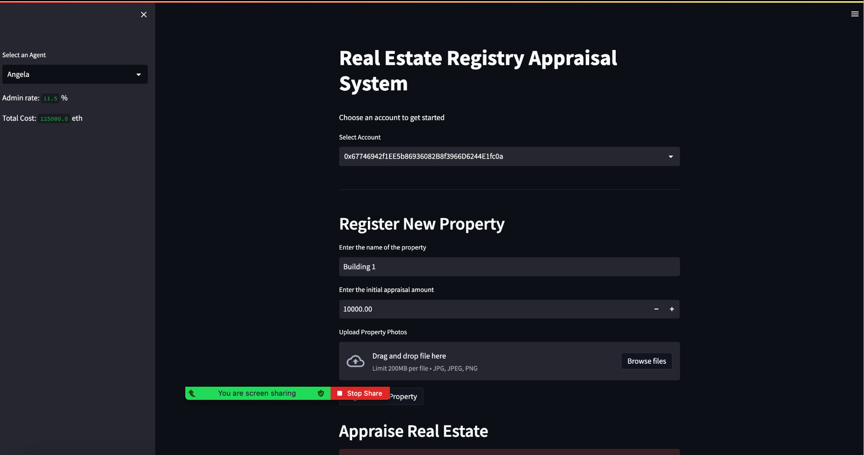
Admin Front End Example

Slide 6
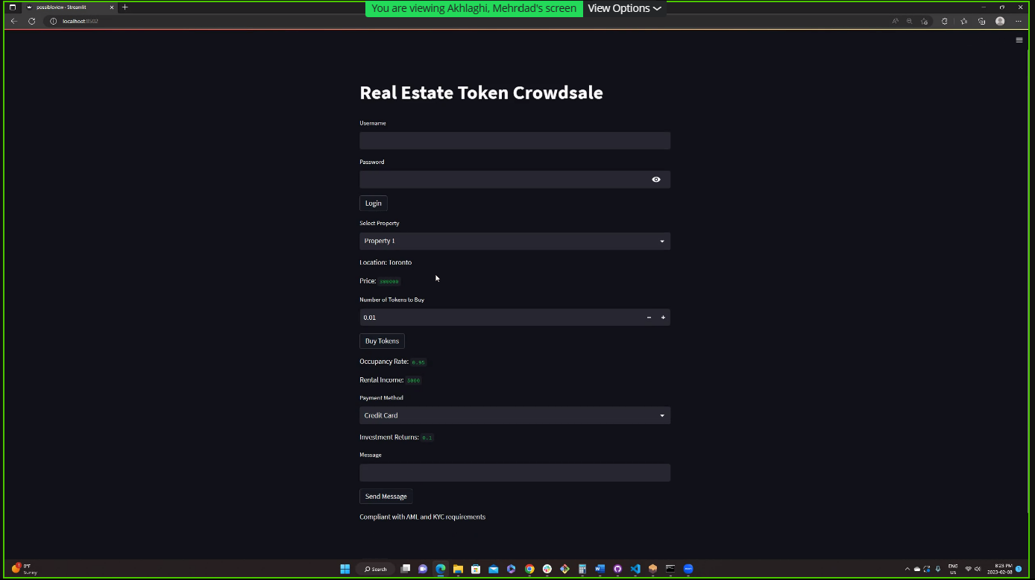
Investor Front End

Slide 7
Demo

